Slide 1
CENG 469 Distributed Algorithms

Slide 2
Distributed Algortihms are conducted on
Set of computers connected by a communication network.
Gives the user an illusion of a single computer
Old platform : Usually a number of WSs over a LAN
Now, ranges from a LAN to a :
sensor network to a mobile network,
body sensor networks,
nano sensor networks,
coded caching networks,
Edge networks

Slide 3
Each node in a Distributed System (DS) :
is autonomous
communicates by messages
needs to synchronize with others
to achieve a common goal (load balancing, fault tolerance, an application..)

Slide 4
There are a number of benefits to be gained by utilizing distributed systems:
One of the obvious advantages of using a distributed system is resource sharing.
Access to a central resource has two disadvantages as this central site becomes a bottleneck for communications and also is a single point of failure.
Distributing the resources such as the database and peripherals over a network can overcome these problems.

Slide 5
Benefits cont’d.
Resources and computation can be replicated at various sites providing fault tolerance as a replica may be substituted in the case of the disfunctioning of a node.
This type of fault tolerance is an important reason to employ
distributed systems.
It is also possible for the application to be inherently distributed such as bank transaction systems and airline reservation systems where employment of distributed systems is inevitable

Slide 6
A distributed system is a collection of entities, each of which is
autonomous, programmable, asynchronous and failure-prone, and communicating through an unreliable communication
medium.
Our interest in distributed systems in this course is about
Study of algorithms rather than systems
We will model the distributed system as a graph G(V,E) where
V is the set of nodes (processors, process on a device)
E is the set of edges (communicationlinks, wired or wireless)

Slide 7
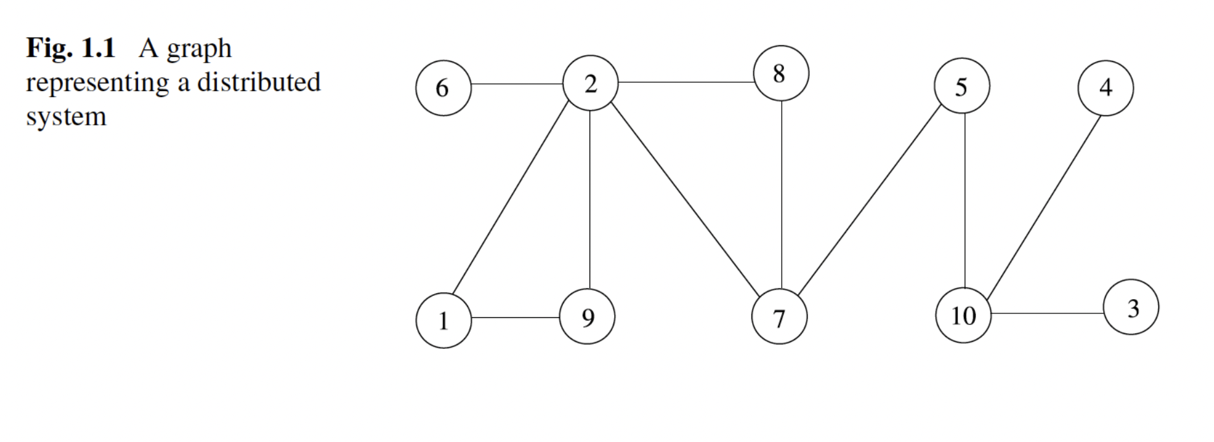
A distributed system can be modeled as a graph G(V,E).

Slide 8
Distributed Computing Platforms
Due to the recent technological advancements, in the last few
decades, we have witnessed diverse distributed system platforms such as:
P2P systems,
The Grid,
The Cloud,
Mobile ad hoc networks, and
Wireless sensor networks,
Nano sensor networks some of which are described below.

Slide 9
The Grid
The Grid consists of loosely coupled, heterogeneous, and geographically dispersed computing elements that are connected by a network acting together to perform large tasks [3].
These computationally intensive scientific tasks may include various applications such as seismic analysis, drug discovery, and bioinformatics problems.
Grid computing provides effective usage of the unused processing power and results in decreased completion time for a task due to parallelization.

Slide 10
The Grid
Middleware
Resource Discovery
Fault Tolerance
Security

Slide 11
The term grid computing originated in the early 1990s as a metaphor for making computer power as easy to access as an electric power grid.
The power grid metaphor for accessible computing quickly became canonical when Ian Foster and Carl Kesselman published their seminal work, "The Grid: Blueprint for a newcomputing infrastructure" (1999)
CPU scavenging and volunteer computing were popularized beginning in 1997 by distributed.net and later in 1999 by SETI@home to harness the power of networked PCs worldwide, in order to solve CPU-intensive research problems
BOINC(Berkeley Open Infrastructure for Network Computing) brings together about 311,742 active participants and 834,343 active computers (hosts) worldwide processing on average 16.912 PetaFLOPS as of 13 January 2017.[

Slide 12
The Grid
The European Grid Infrastructure (EGI)
High-energy physics,
Earth observation,
Biology applications
The United States, the National Grid (USNG)
Access grid for people

Slide 13
The Cloud
The cloud computing evolved from grid computing
Cloud computing provides computation, software applications, data access, data management, and storage for resources without requiring cloud users to know the location and other details of the computing infrastructure.
Grid computing may be included in the cloud or not depending on the type of application.
Grid computing may be included in the cloud or not depending on the type of application and users.

Slide 14
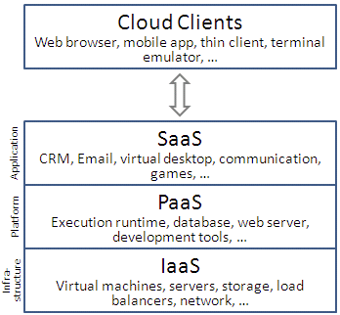
Cloud Flavors?
SaaS – Software as a Service
PaaS – Platform as a Service
IaaS – Infrastructure as a Service

Slide 15



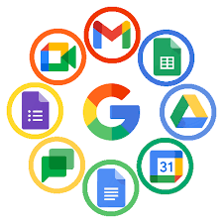

SaaS Examples

Slide 16
Platform as a Service (PaaS)
PaaS provides all of the facilities requiredto support the complete life cycle of building and delivering web applications and services entirely from the Internet.
Typically applications must be developed with a particular platform in mind
Highly scalable multi tier architecture

Slide 17
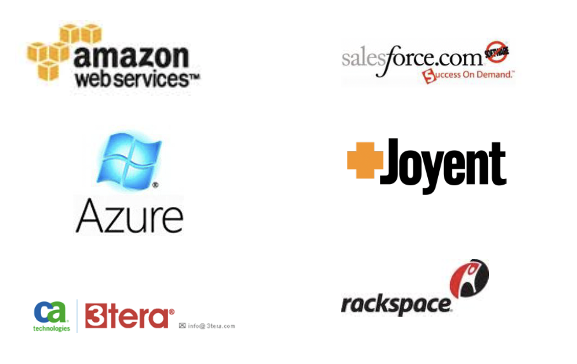
PaaS Examples

Slide 18
Infrastructure as a Service (IaaS)
IaaS is the delivery of technology infrastructure as an on demand scalable service
Usually billed based on usage
Can be coupled with Managed Services for
OS and application support

Slide 19



IaaS Examples

Slide 20
The Cloud
In 2013, it was reported that cloud computing had become a highly demanded service or utility due to the advantages of high computing power, cheap cost of services, high performance, scalability, accessibility as well as availability. Some cloud vendors are experiencing growth rates of 50% per year, but being still in a stage of infancy, it has pitfalls that need to be addressed to make cloud computing services more reliable and user friendly

Slide 21
The Cloud cont’d.
The origin of the term cloud computing is unclear. The word "cloud" is commonly used in science to describe a large agglomeration of objects that visually appear from a distance as a cloud and describes any set of things whose details are not further inspected in a given context.
Another explanation is that the old programs that drew network schematics surrounded the icons for servers with a circle, and a cluster of servers in a network diagram had several overlappingcircles, which resembled a cloud.

Slide 22
Mobile Ad Hoc Networks (MANET)
A wireless ad hoc network is a decentralized network consisting of wireless nodes that do not rely on a predefined infrastructure such as routers or access points.
Instead, each node participates in routing by forwarding data to other nodes regarding dynamically changing network topology

Slide 23
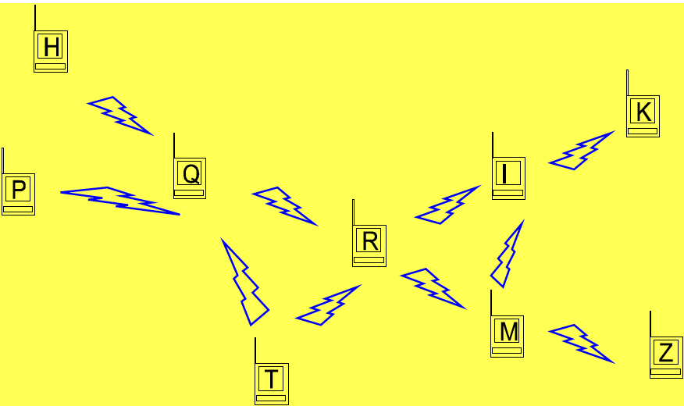
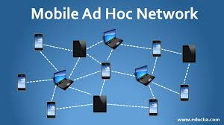
MANET

Slide 24
Wireless Sensor Networks
A wireless sensor network (WSN ) consists of many small nodes of computing elements, each equipped with sensing and wireless communication capabilities.
habitat monitoring,
military surveillance, and target
Tracking
WSNs form a large-scale distributed system and require scalable distributed algorithms to solve problems such as data aggregation, topology control and routing.

Slide 25
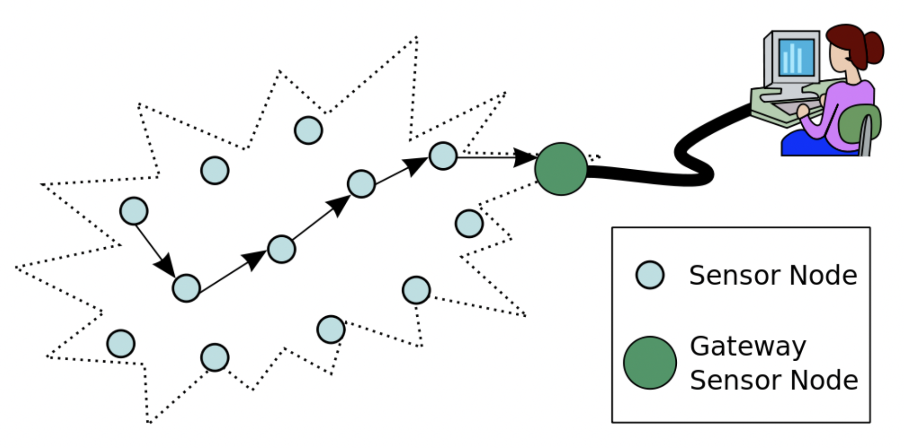
Wireless Sensor Networks

Slide 26
Distributed System Communication Models
Message Passing
Synchronous
Asyncronous
Memory
Shared Memory
Distributed Memory

Slide 27
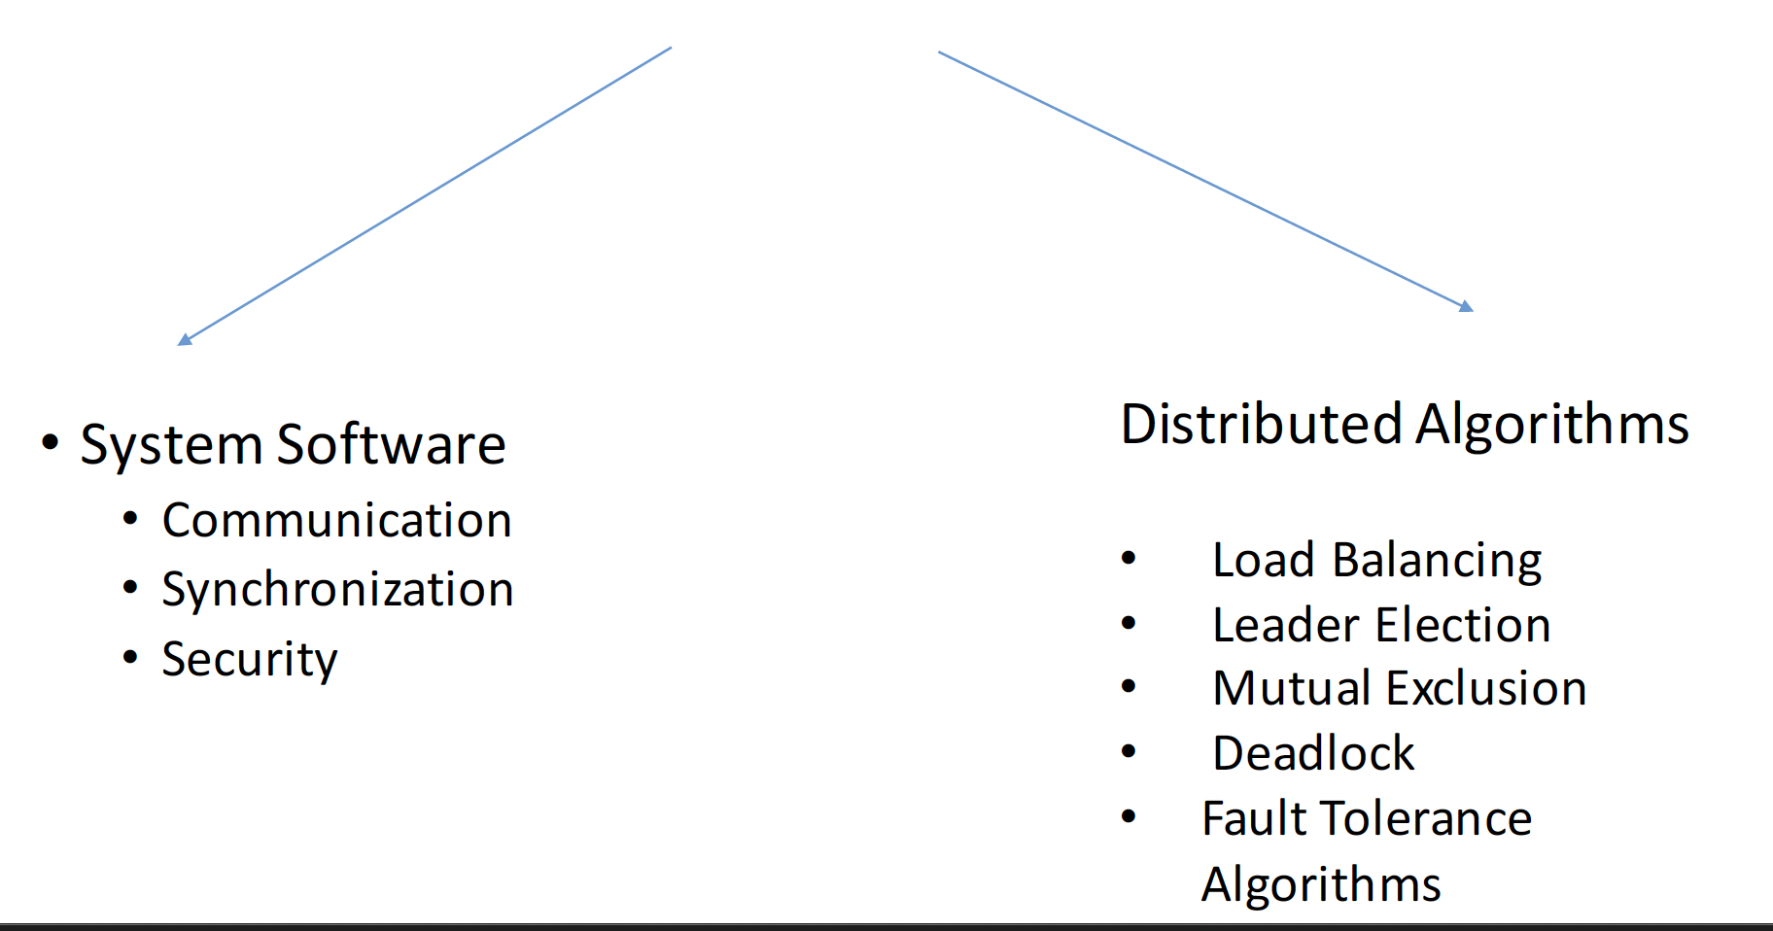
Distributed Systems Design Issues

Slide 28
The Aim of the Course
The aim of this course is the design of such distributed approximation graph algorithms that may be of use in distributed applications.
As a concrete example, finding a minimum connected dominating setthat is the subset V’ of vertices of a graph G with minimum size such that every vertex of the graph is either in V’ ora neighbor of V’ and all of the vertices in V are connected is NP-hard for general graphs.
Therefore finding an approximation algorithm that has a better approximation than the best known algorithm is clearly a contribution on its own.

Slide 29
Course Overview
Graphs
Models
Spanning Tree Construction
Graph Traversal
Routing
Vertex Coloring
Dominating Sets
Time Clocks
Distributed Mutual Exclusion

